Slide 1
cbrt

Slide 2
Definition:
sympy.functions.elementary.miscellaneous.cbrt(arg, evaluate=None
Returns the principal cube root.
Parameters
evaluate : bool, optional
The parameter determines if the expression should be evaluated. If None, its value is taken from global_parameters.evaluate.

Slide 3
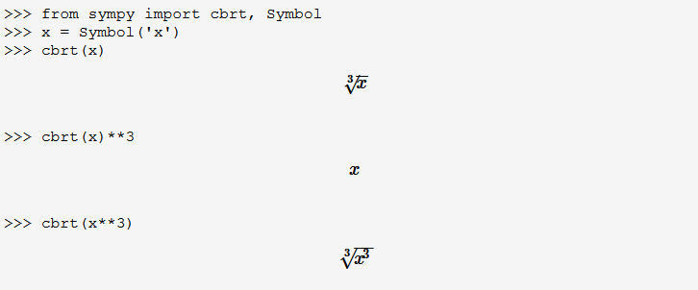
Example

